Slide 1

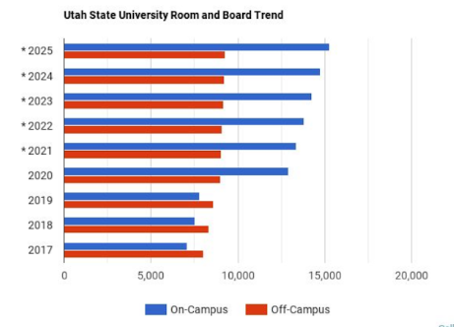
The real cost of on campus housing:
There is NO free parking at on campus housing at USU
Some on campus housing REQUIRES the purchase of a parking permit, regardless if the resident owns a car.
There are only 8,924 parking spots available to accommodate the student and staff population at usu. With there being more that 3500 students living on campus and 18,160 students total, the Student/faculty Ratio is 19.5 to 1.
Dorm rooms at colleges and universities average around 12 by 15 feet. This is approximately 180 square feet of actual living space. That’s about the size of a one-car garage. Within that space, you will probably have a roommate.
Average total costs of USU on-campus housing is about 130% that of off campus housing.
At 4-year institutions, the cost of room and board ranges from $8,556 to $12,870

